Slide 1
Conflict-free Replicated Data Types Marc Shapiro, Nuno Preguiça, Carlos Baquero, Marek Zawirski
Presented by
Shashwat Gupta

Slide 2
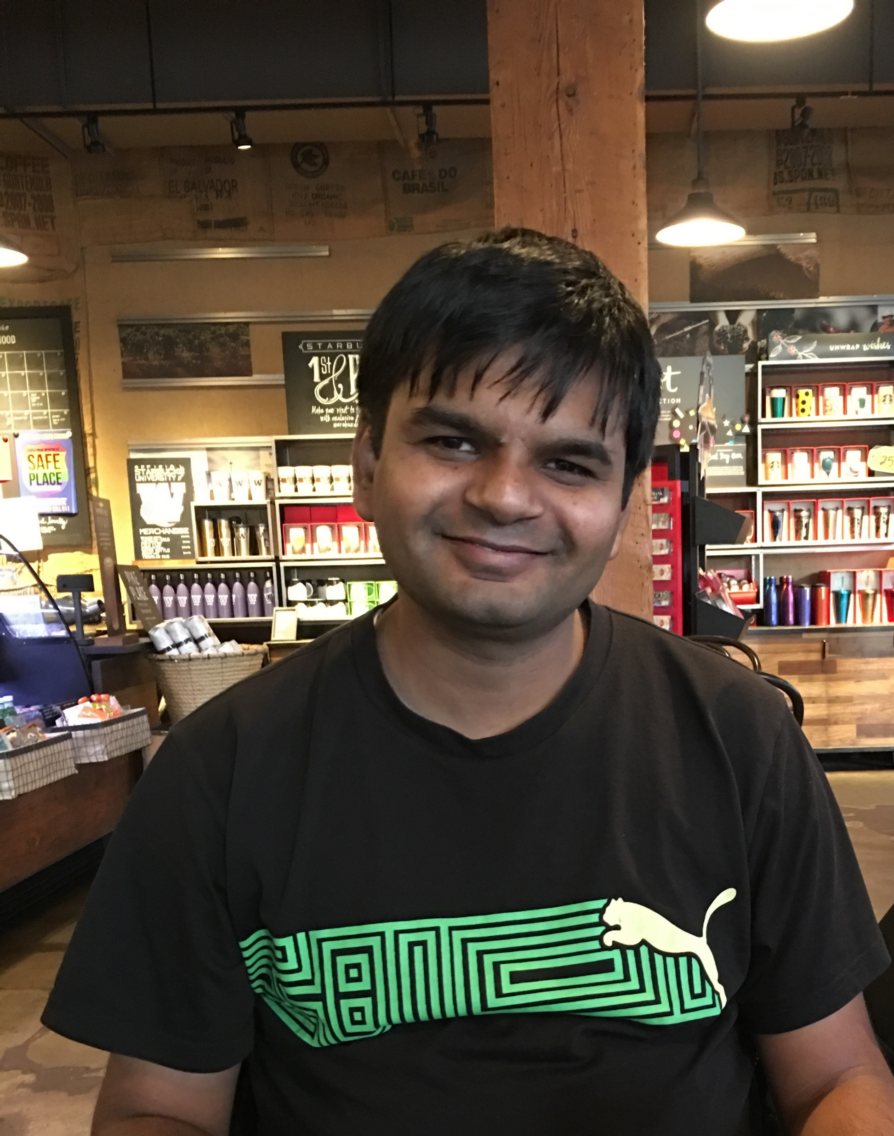
About Me
Shashwat Gupta
Principal Software Engineer @ Microsoft
Currently works on Azure Active Directory

Slide 3
Agenda
Introduction (Why do we need CRDTs)
State Based CRDTs
Operation Based CRDTs
Example use in real life system

Slide 4
Introduction

Slide 5
Eventual Consistency
Lets Define it
Eventual Delivery (liveness property)
Don't loose data! ( safety property)
Convergence (Have same state)
➔ This makes EC a SEC

Slide 6
Understanding Concurrency!
Distinction between “concurrency” and “parallelism”
Concurrent execution does not mean happening at the same time but executions being unaware of each other
For Offline Devices concurrent execution could be apart by days.
Q: What tools do you use daily which have concurrency.
A: Git Repo

Slide 7
Collaborative Editing
H | E | L | 0
1 | 2 | 3 | 4
H | E | L | 0
1 | 2 | 3 | 4

Slide 8
Collaborative Editing
H | E | L | L | 0
1 | 2 | 3 | 4 | 5
H | E | L | 0 | !
1 | 2 | 3 | 4 | 5

Slide 9
Collaborative Editing
Insert L Position 4
H | E | L | L | 0
1 | 2 | 3 | 4 | 5
H | E | L | 0 | !
1 | 2 | 3 | 4 | 5
Insert ! Position 6

Slide 10
Collaborative Editing
H | E | L | L | 0 | !
1 | 2 | 3 | 4 | 5 | 6
H | E | L | L | 0 | !
1 | 2 | 3 | 4 | 5 | 6

Slide 11
Replica Affinity
Affinized replica is required to keep the state
Problem
Single Point of Failure!!

Slide 12
Consensus based approach
Quorum based Approach
Using Paxos Or Raft
Problem
Consensus is hard
Can only tolerate N/2 machine failures
Its slow

Slide 13
Few more Problems
Needs to be Online for editing
Server have Knowledge of your document

Slide 14
Collaborative Editing(CRDTs)
a
b
Insert ! at position after 4a
H | E | L | 0
1a | 2a | 3a | 4a
H | E | L | 0
1a | 2a | 3a | 4a
Insert L at position after 3a

Slide 15
CRDT Definition (From Wikipedia)
In distributed computing, a conflict-free replicated data type (CRDT) is a data structure which can be replicated across multiple computers in a network, where the replicas can be updated independently and concurrently without coordination between the replicas, and where it is always mathematically possible to resolve inconsistencies which might result

Slide 16
Why CRDTs
It offers local latency on read and write operations, regardless of the number of geo-replicated regions and their distance from each other.
It enables seamless conflict resolution (“conflict-free”) for simple as well as complex data types
Even if the majority of geo-replicated regions are down, the remaining geo-replicated regions are uninterrupted and can continue to handle read and write operations.

Slide 17
Most Basic CRDT Type
Flags
- Denotes whether a event happened or not.

Slide 18
State Based CRDTs

Slide 19
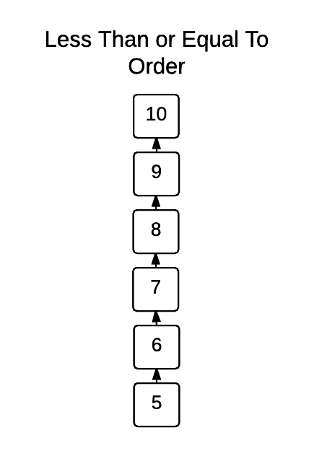
Understanding Join Semilattice
Total Order

Slide 20
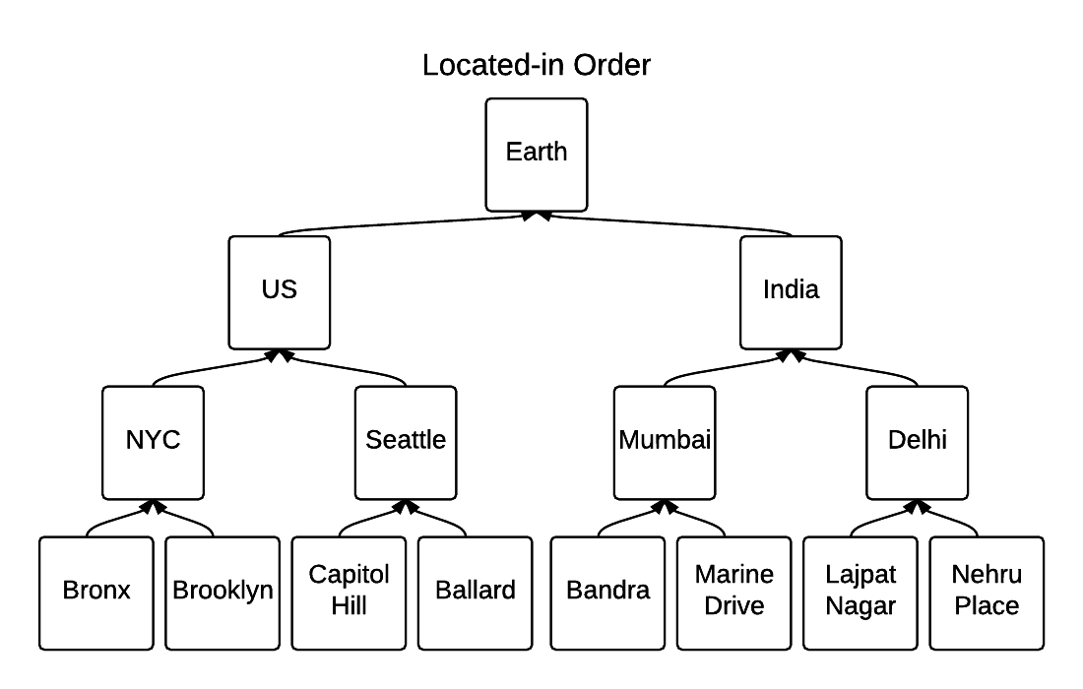
Understanding Join Semilattice

Slide 21
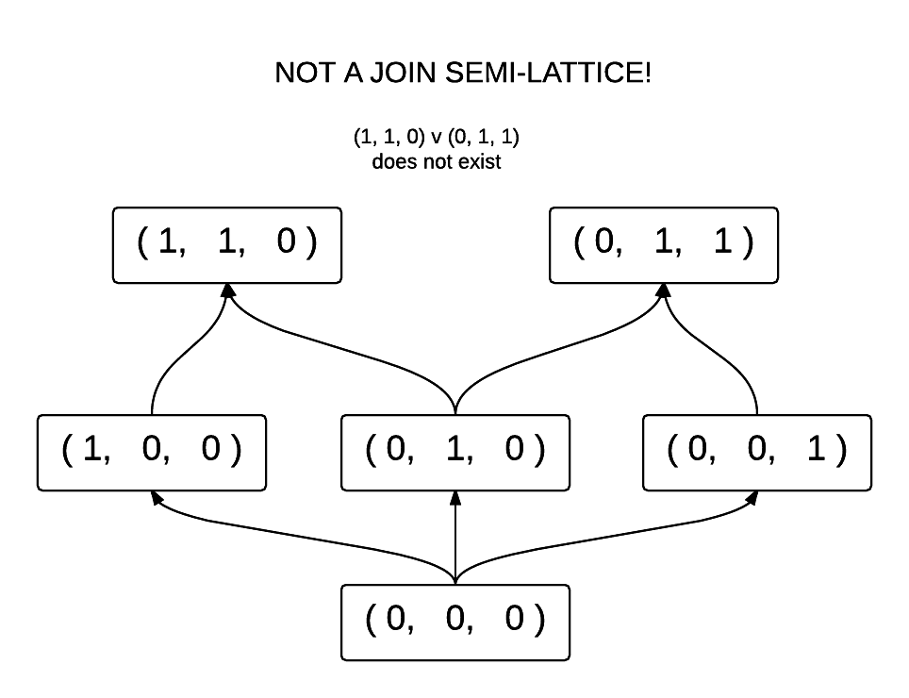

Slide 22
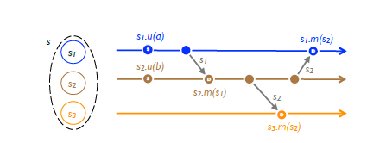
State-based Convergent Replicated Data Type (CvRDT)

Slide 23
Sufficient Condition for CvRDT
Prove that its states form a Join semilattice and merge computes a Least Uppper Bound.

Slide 24
Implementation of CRDT
An object is a tuple (S, ≤, s0, q, u,m).
The replica at process pi has state
si ∈ S, called its payload;
Initial state is s0.
A client of the object may
read the state of the object via query method q
modify it via update method u.
method m serves to merge the state from a remote replica.

Slide 25
Counters (G-Counter & PN-Counter)
G Counter → P2P “I Like It/I Don’t Like It” poll, as is common in social networks.
PN Counter → to count the number of users logged in to a P2P application such as Skype.
This data type is a CvRDT, as its states form a monotonic semilattice, and merge produces the LUB.
How would you handle Non-negative Counter?
Notes:
To Do
→ Create Monotic SemiLattice diagram
Talk
→ A correct approach is to enforce a local invariant that implies the global invariant: e.g., rule that a client may not originate more decrements than it originated increments

Slide 26
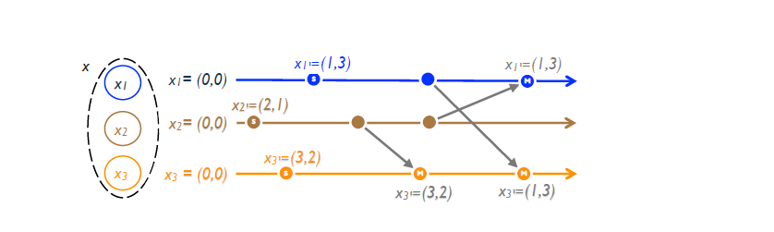
Registers (LWW register)
Timestamps are assumed unique, totally ordered and consistent with causal order
(Of Couse this is not true in Practice because of clock drift!)
Downstream, the update takes effect only if the new timestamp is greater than the current one. Because of the way timestamps are generated, this preserves

Slide 27
OP Based CRDTs

Slide 28
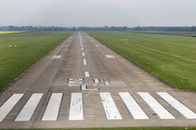
Causal History Example
FD 50
LT 90
FD 20
RT 90
FD 50

Slide 29
FD 50
FD 50
FD 50
FD 50

Slide 30
FD 50
LT 90
FD 50
Boom
FD 50
FD 50

Slide 31
FD 50
LT 90
FD 50
LT 90
FD 50
FD 50
LT 90

Slide 32
FD 50
LT 90
FD 20
RT 90
FD 50
FD 50
LT 90
FD 20
RT 90
FD 50
FD 50
FD 20
RT 90
LT 90
FD 50
FD 50
LT 90
FD 20
RT 90
FD 50

Slide 33
Fix
Whenever sending Current Command Send a whole Causal History as well.
In This case LT 90 (Should have Causal History of FD 50)

Slide 34
Version Vector
https://riak.com/why-vector-clocks-are-easy/

Slide 35
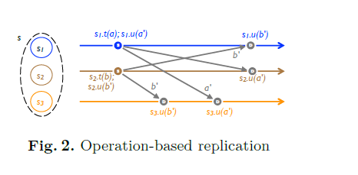
Operation Based CRDTs

Slide 36
Sufficient Condition for Op based CRDTs
Commutative property
If delivered in causal order then concurrent have to commute
If delivered without respecting causal order then all operation have to commute
Idempotent if it can be delivered more than once.
Reliable transmission protocol

Slide 37
Op-based Commutative Replicated Data Type (CmRDT)
An object is a tuple (S, s0, q, t, u, P)
t (prepare-update) – Gets executed only on source replica (Side-effect free)
U (effect-update) – Get executed on all replicas
P – delivery mechanism, effect-update method u is enabled only if the precondition(‘P’) is satisfied.

Slide 38
CvRDT == CmRDT
Any SEC state-based object can be emulated by a SEC op-based object of a corresponding interface.
Any SEC op-based object can be emulated by a SEC state-based object of a corresponding interface.

Slide 39
Other CRDT Types
Graphs
DAGs
Sequences

Slide 40
Example Use In Real system
Redis
Riak
Bet 365
Leage Of legends
Roshi by SoundCloud

Slide 41
References
Complete reading list on CRDT http://christophermeiklejohn.com/crdt/2014/07/22/readings-in-crdts.html
Eventual Consistency
http://www.bailis.org/blog/safety-and-liveness-eventual-consistency-is-not-safe
Understanding Semilattice
http://jtfmumm.com/blog/2015/11/17/crdt-primer-1-defanging-order-theory/
https://redislabs.com/redis-enterprise/technology/active-active-geo-distribution/
https://docs.riak.com/riak/kv/2.0.2/learn/concepts/crdts/

